Slide 1
Tuberculosis Drugs
Spreadsheet Documentation
Click below for:
Impact Summary Sheet

Slide 2
General Information
Click here for access to the Spreadsheet
Spreadsheet contains data regarding
Summary of company rankings
WHO groupings and country categorizations
The burden of TB and the data of its drugs by countries
The burden of HIV and the data of its drugs by countries
Notes:
??? The burden of Malaria and the data of its drugs by countries ???

Slide 3
Definitions
WHO region- designated regions provide by the World Health Organization
Taken from
Official WHO website- neglected tropical diseases
DALY- disability adjusted life year (D)
∑(years lost to premature mortality + years lost to disability due to schistosomiasis)
Treatment Coverage- percentage of people afflicted that were treated (θ)
= # treated/ prevalence
Efficacy- percentage of population receiving treatment that were actually cured (e)
Data generated from WHO, UNAID database

Slide 4
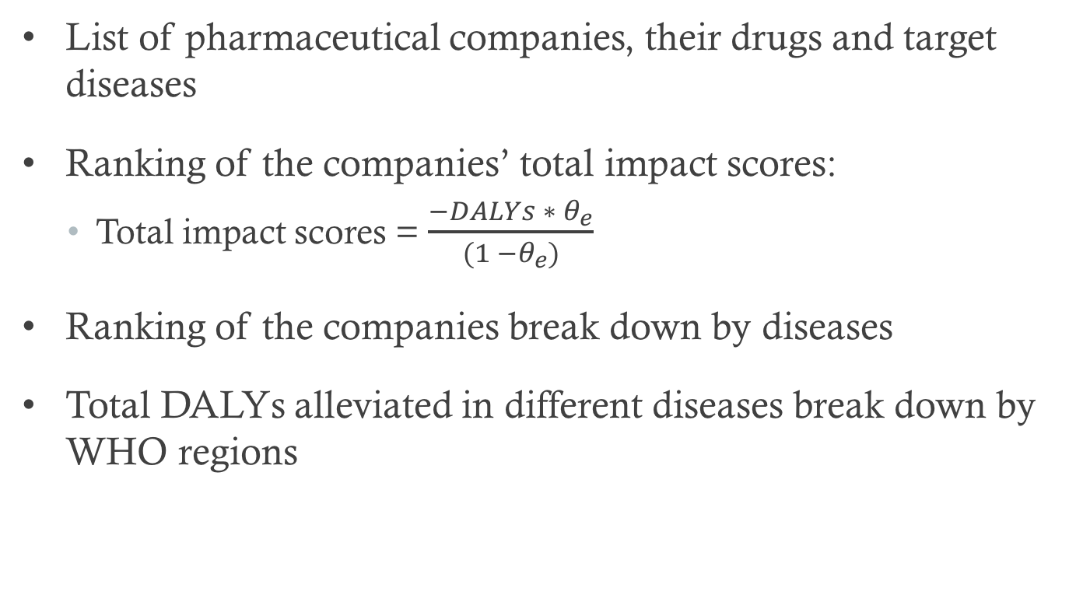
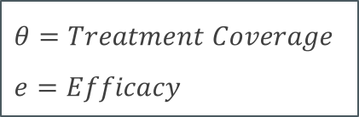
Summary of Company Rankings

Slide 5
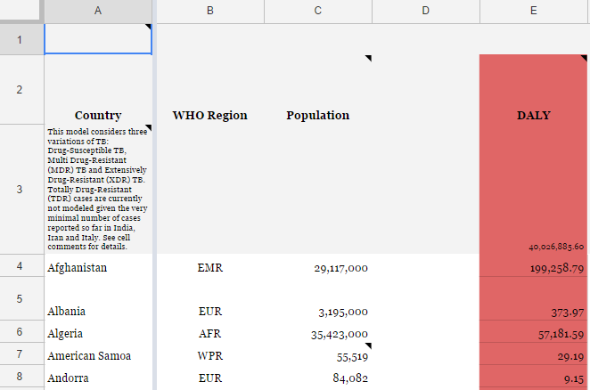
Tuberculosis by Countries
Column A: List countries
Column B: Countries sorted by WHO regions
Column C: population
Column E: DALYs lost to TB breakdown by countries (2015 data)

Slide 6
Tuberculosis by Countries
Different kinds of TB
Drug-susceptible (Normal) TB
Multiple drug resistant (MDR) TB
Extreme drug resistant (XDR) TB
TB and HIV
All TB Incident Cases
Drug-Susceptible ("Normal") active TB
HIV+
HIV-
MDR-TB
XDR-TB

Slide 7

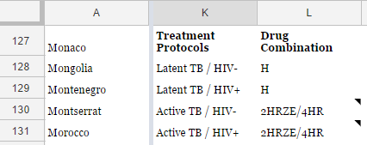
TB regimens and treatment protocols
Cells K40:L44 Standard treatment protocols
Cells K127:L139 Drug-resistant treatment protocols

Slide 8
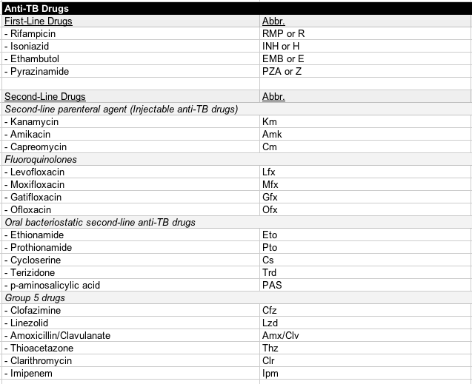
List of Anti-TB drugs
Cells K141:M170: List of Anti-TB drugs

Slide 9
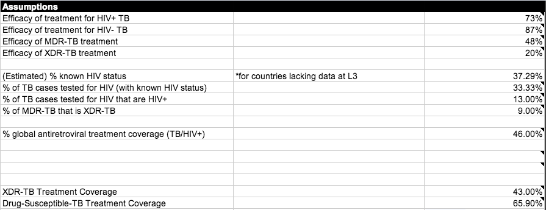
Tuberculosis Assumptions
Cells K21:M38: Assumptions

Slide 10
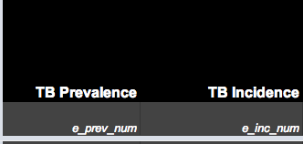
Prevalent and incidence cases
Columns N and O: TB prevalence and incidence by countries
Prevalence: The total number of cases of disease existing in a population
Incidence: The total number of newly diagnosed cases of a disease

Slide 11
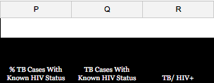
HIV Status
Column P: The percent of TB cases with a known HIV status, according to the WHO
Column Q: The number of TB cases with known HIV status (WHO)
Column R: Number of cases that are TB/HIV+

Slide 12
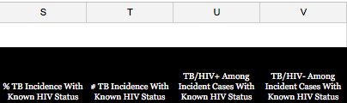
Prevalent and incidence cases
Columns S-V:
Incident cases of active TB with HIV+/HIV-
% of active TB with HIV+/HIV- = The number of active TB with HIV+ or HIV- / The number of TB incidence with known HIV status.

Slide 13
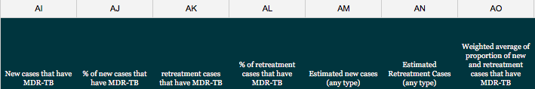
Calculating Impact Score: MDR-TB
DALYs lost to MDR-TB by country
Columns AI-AO: Calculating proportion of cases that have MDR-TB (column AO)
AK/AL= AN
AI/AJ = AM
(AI+AK) / (AM+AN) = AO

Slide 14
Calculating Impact Score: MDR-TB
#MDR-TB needing treatment (AP) = TB prevalence (N) * proportion of new and retreatment cases that have MDR-TB (AO)
DALYs lost to MDR-TB (AS) = Total DALYs lost to TB (E) * MDT-TB proportion (AO) – DALYs lost to XDR-TB (BB)
Treatment Coverage of MDR-TB by country (AR) = # MDR-TB receiving treatment (AQ) / # MDR-TB needing treatment (AP)
Treatment Efficacy of MDR-TB (K24): Assumption
AT: Impact of MDR-TB treatment regimen = Need (DALYs lost to MDR-TB (AS)) * MDR-TB treatment coverage (AP/R) * MDR-TB treatment efficacy (K24)

Slide 15

Calculating Impact Score: MDR-TB
Cells K172:L177: The proportion of the impact each regimen in the MDR-TB treatment protocols is inversely proportional to resistance rates

Slide 16
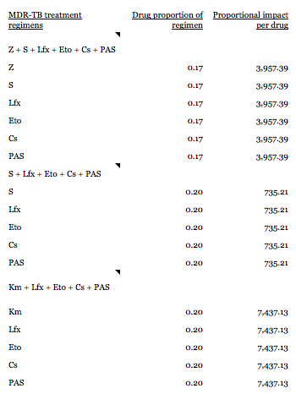
Calculating Impact Score: MDR-TB
Cells K46:M65
Each drug within each regimen receives an equal proportion of that regimen’s impact
A company’s total impact of MDR-TB regimen =

Slide 17
Calculating Impact Score: MDR-TB
A company’s total impact of XDR-TB regimen = The company’s proportion of credit for MDR-TB treatment (based on the sum of the anti-MDR-TB drugs it produces) multiplied by the sum of impact of MDR-TB treatment regimen in each country.

Slide 18
Calculating Impact Score: XDR-TB
DALYs lost to XDR-TB by country
Assumption K30: 9% of all MDR-TB cases are XDR-TB (WHO 2013)
DALYs lost to XDR-TB (BB) = Total DALYs lost to MDR-TB (E) * MDR-TB proportion (AO) * 9%
XDR-TB Treatment Coverage (BA) = 57% (assumption K37)
XDR-TB treatment Efficacy (K25) = 22% (assumption K25)
Impact of XDR-TB treatment regimen (BC) = Need (DALYs lost to XDR-TB (BB)) * XDR-TB treatment coverage (BA) * XDR-TB treatment efficacy (K25)

Slide 19

Calculating Impact Score: XDR-TB
Cells K85:M89: The total impact of XDR-TB treatment is divided according to XDR-TB treatment protocols
A company’s total impact of XDR-TB regimen = The company’s proportion of credit for XDR-TB treatment (based on the sum of the anti-XDR-TB drugs it produces) multiplied by the sum of impact of XDR-TB treatment regimen in each country.

Slide 20
Calculating Impact Score: Normal TB – Needs
Total DALYs lost to TB/HIV+ (AB) = Total DALYs lost to TB (E) – the DALYs lost to MDR-TB (AS) – the DALYs lost to XDR-TB (BB)
Total DALYs lost to TB/HIV- (AC) = Total DALYs lost to TB (E) – the DALYs lost to MDR-TB (AS) – the DALYs lost to XDR-TB (BB)

Slide 21
Calculating Impact Score: Normal TB – Access and Efficacy
Treatment coverage for TB/HIV+ (AD) = 58% (Assumption about drug-susceptible TB treatment coverage (K38))
Treatment coverage for TB/HIV- (AE) = 58% (Assumption about drug-susceptible TB treatment coverage (K38))
Treatment Efficacy of TB/HIV+ (K22): 73% (assumption K22)
Treatment Efficacy of TB/HIV- (K23): 88% (assumption K23)

Slide 22
Calculating Impact Score: Normal TB
A company’s total impact of normal TB regimen = The company’s proportion of credit for standard treatment multiplied by the sum of the impacts of the normal TB treatment regimen in each country.

Slide 23
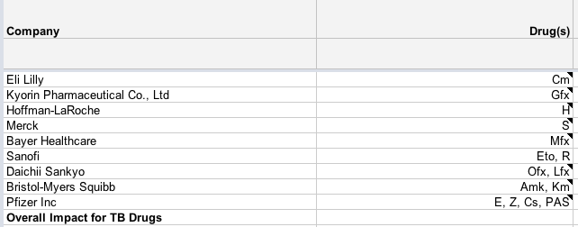
Calculating Impact Score by Companies
Cells K4:M13 Companies and their drugs
A company’s total impact score in TB = The sum of total impact score in treating normal TB, MDR-TB and XDR-TB

Slide 24
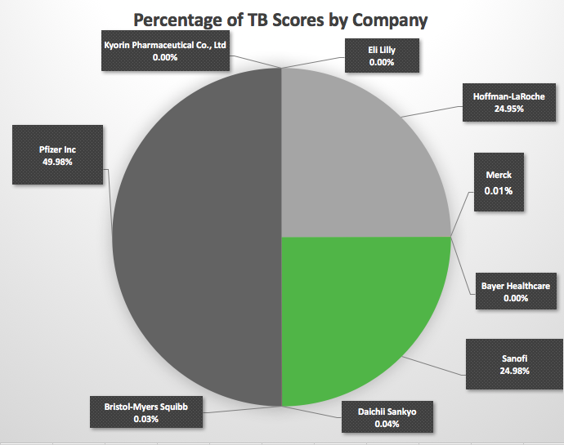
Total TB Impact Scores by Companies

